Slide 1
Embed a Backdoor in an Image

Slide 2
Turn anti-virus off

Slide 3
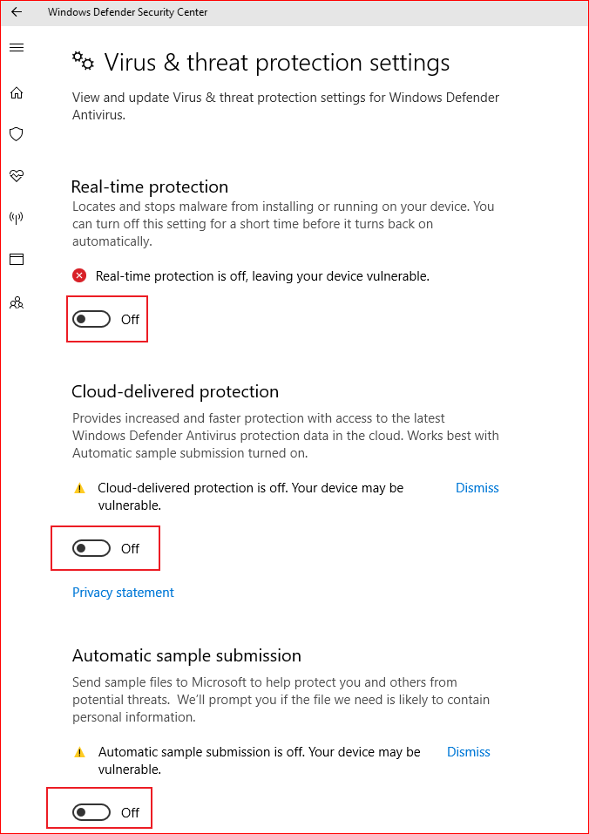
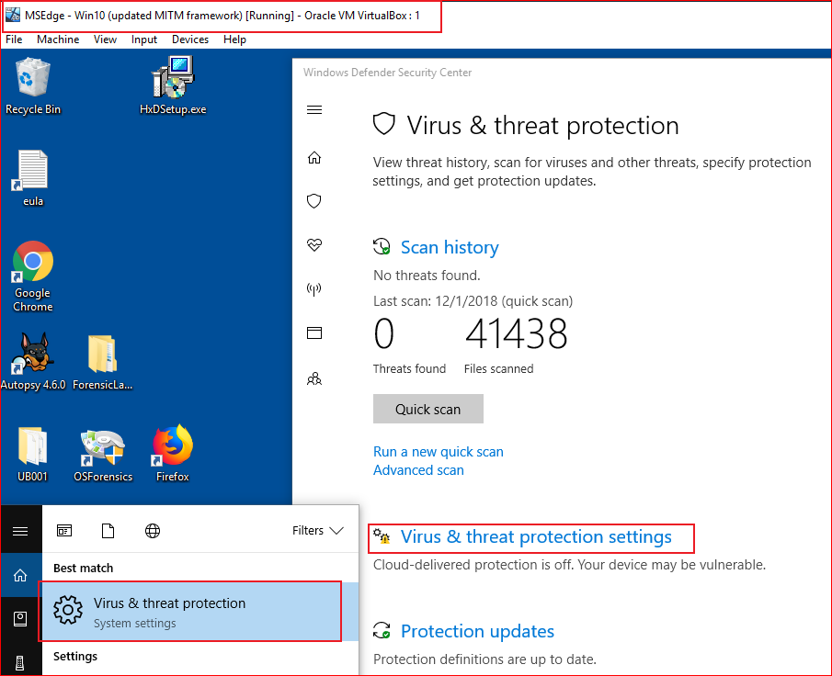

Slide 4
Optional
How to permanently disable Windows Defender Antivirus on Windows 10?
https://www.windowscentral.com/how-permanently-disable-windows-defender-antivirus-windows-10

Slide 5
Upload backdoors and images

Slide 6
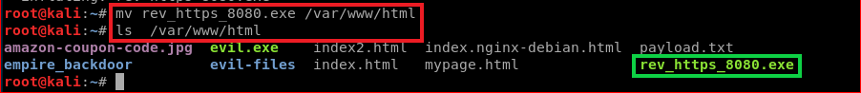
Upload a backdoor to Kali web server
Assume you have created a backdoor named “rev_https_8080.exe”
Assume the backdoor is in the root directory
Notes:
https://www.dropbox.com/s/fkho85h90jlck51/rev_https_8080.zip

Slide 7
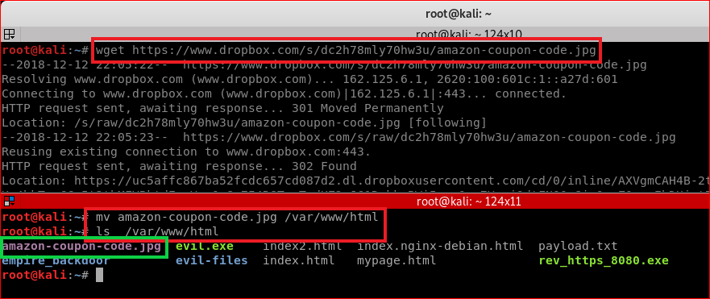
Upload an image to Kali web server
https://www.dropbox.com/s/dc2h78mly70hw3u/amazon-coupon-code.jpg

Slide 8
Install gcc compiler

Slide 9
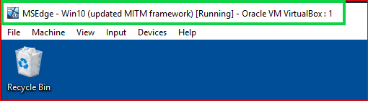
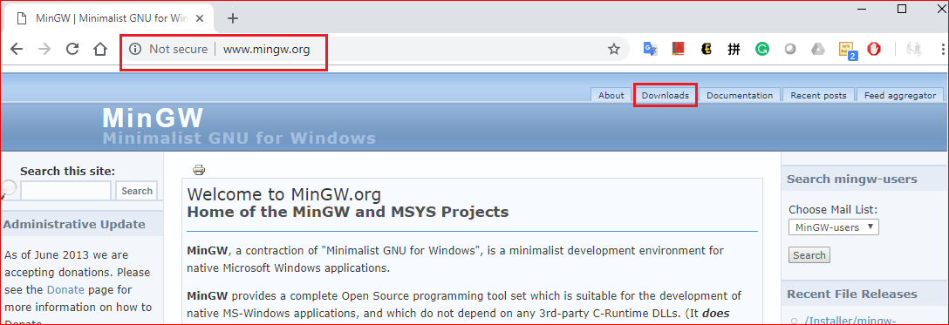

Slide 10
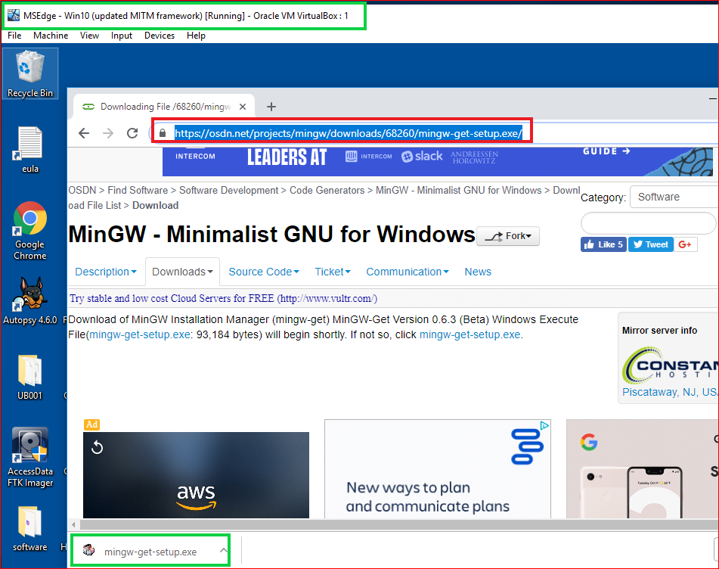

Slide 11
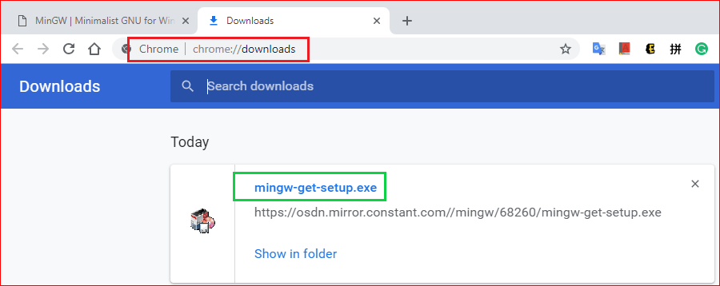

Slide 12
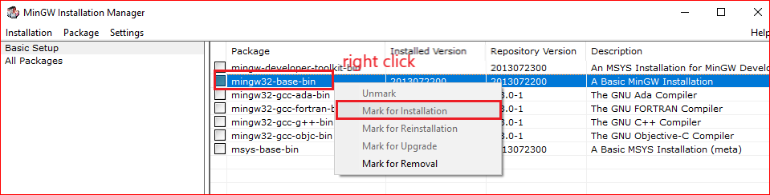

Slide 13
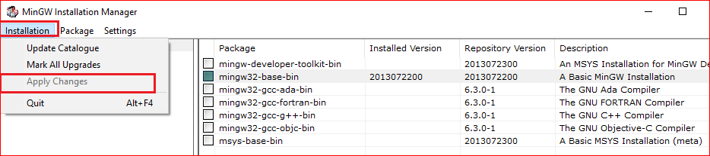

Slide 14
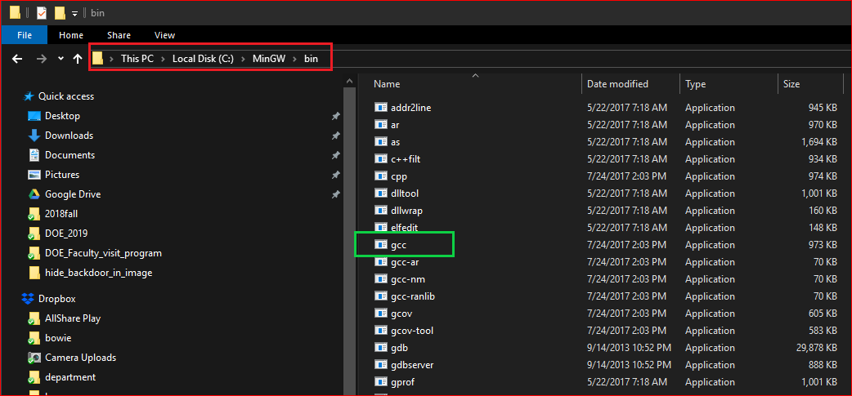

Slide 15
Combine a backdoor with an image

Slide 16
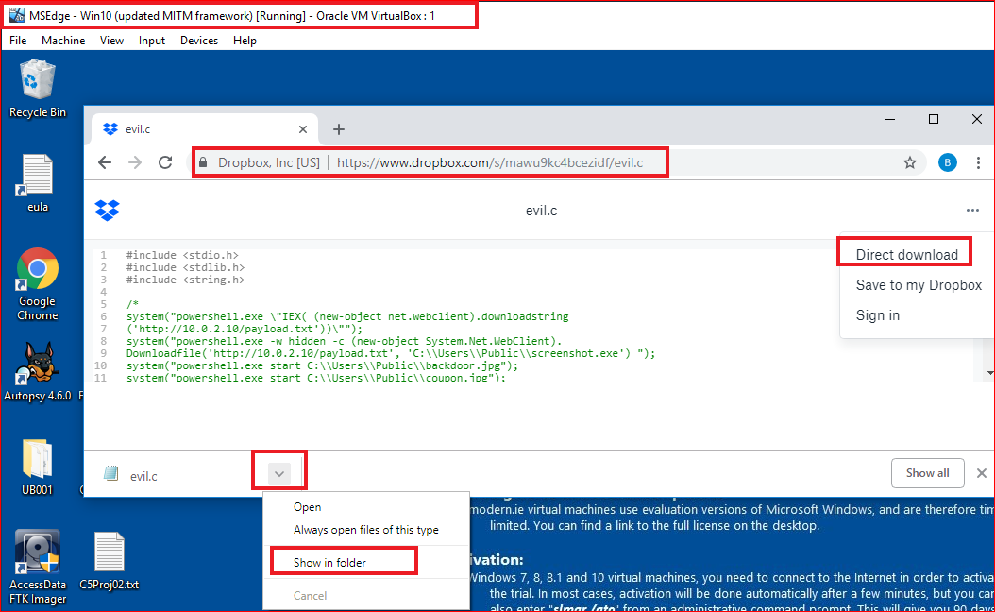
Download evil.c
https://www.dropbox.com/s/mawu9kc4bcezidf/evil.c

Slide 17
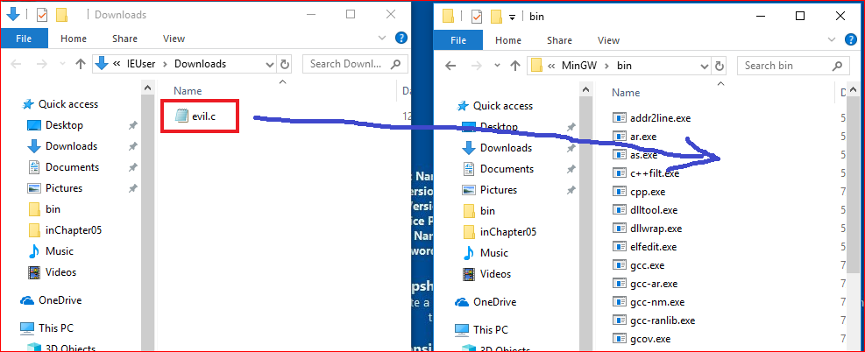
Copy to

Slide 18
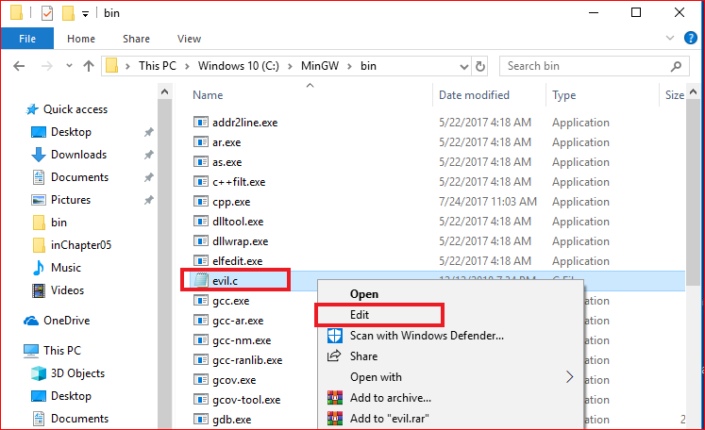

Slide 19
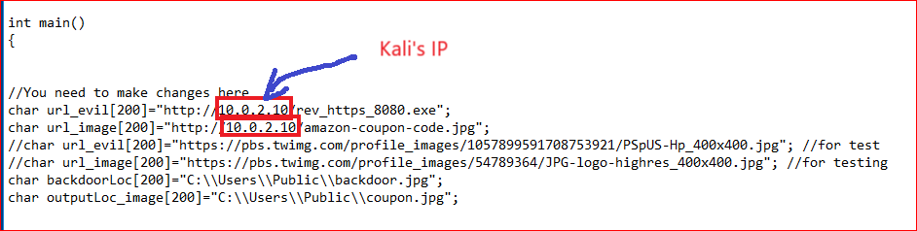

Slide 20
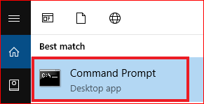
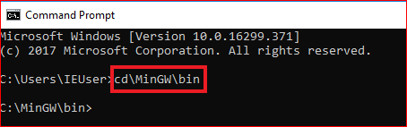
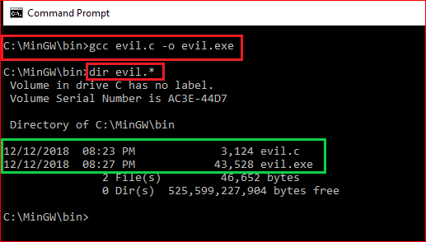

Slide 21
Change the icon of the evil.exe

Slide 22
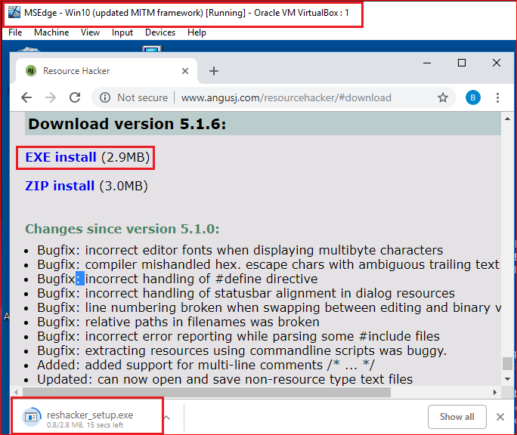
Install recourse hacker

Slide 23
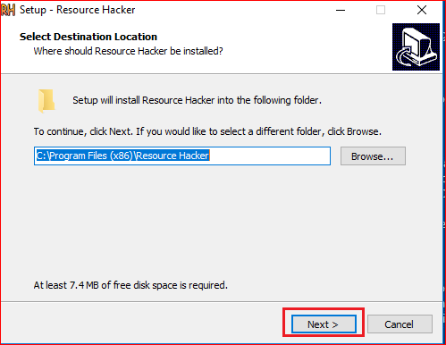
Install Resource Hacker

Slide 24
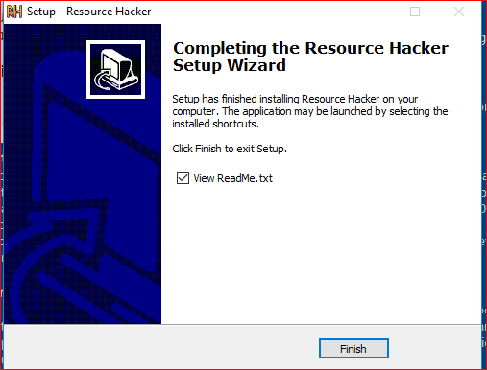
Finish installation

Slide 25
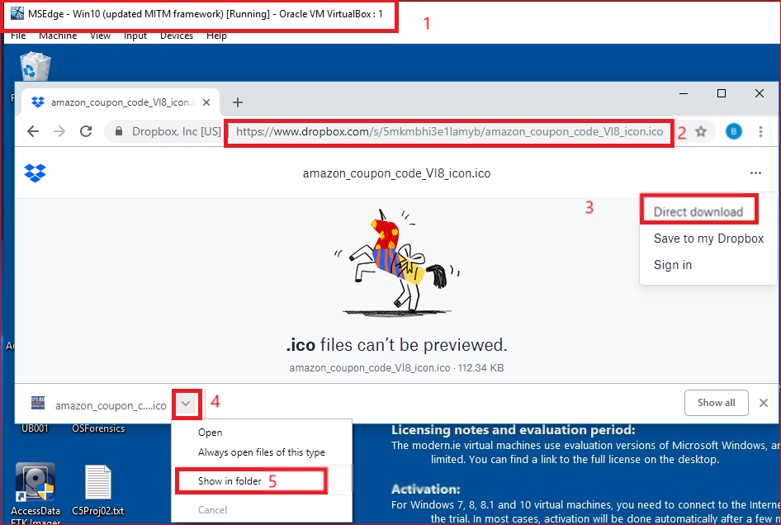
Download icon
https://www.dropbox.com/s/5mkmbhi3e1lamyb/amazon_coupon_code_Vl8_icon.ico

Slide 26
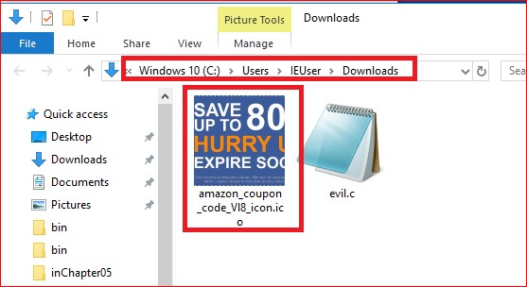

Slide 27
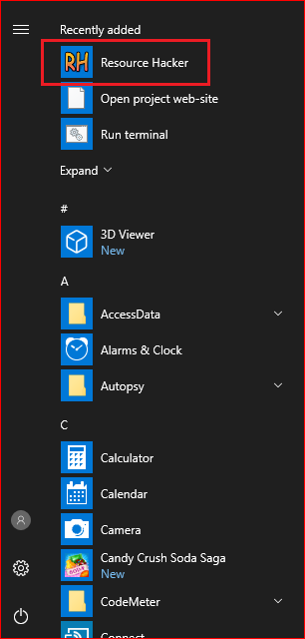
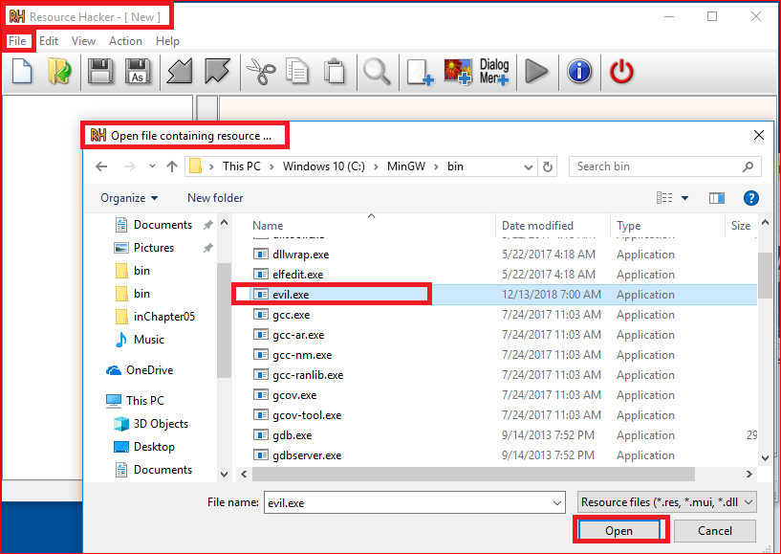

Slide 28
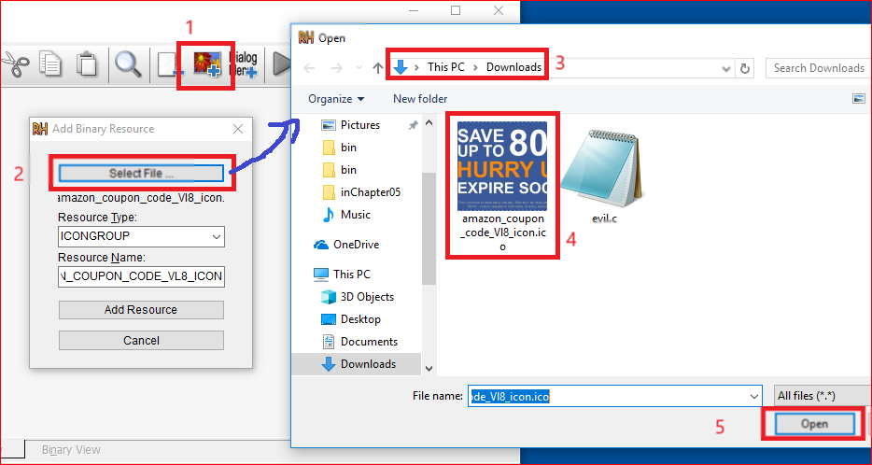

Slide 29
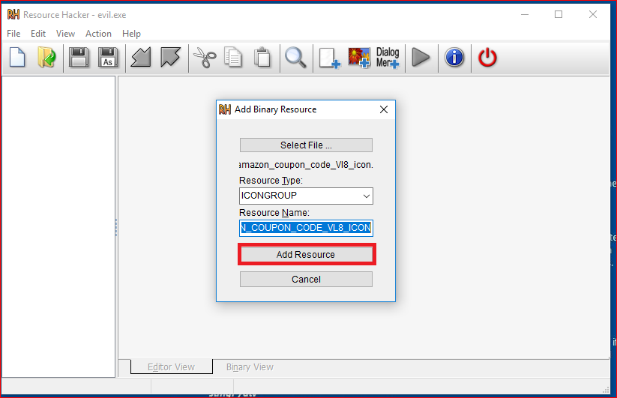

Slide 30
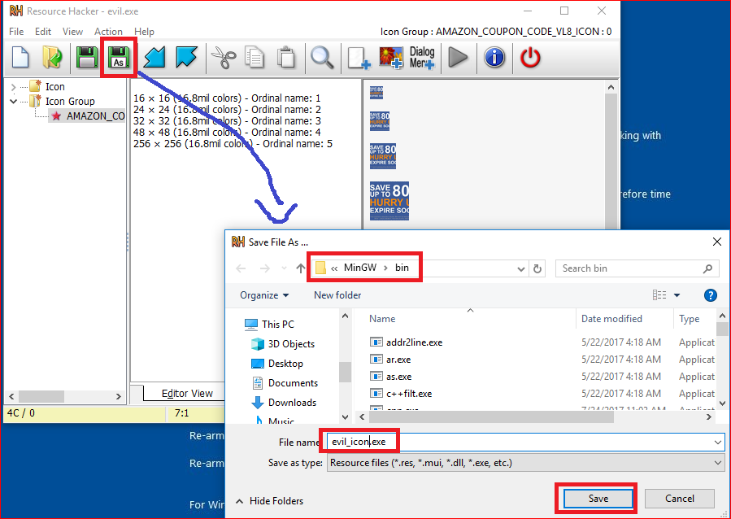

Slide 31
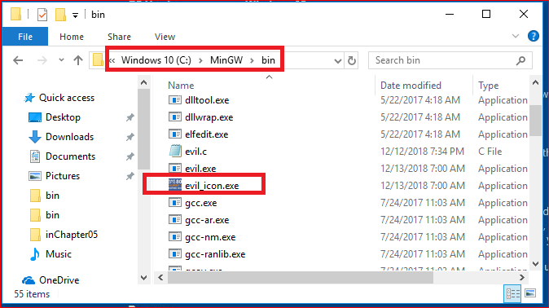

Slide 32
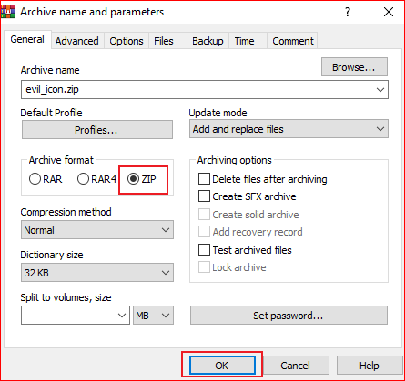
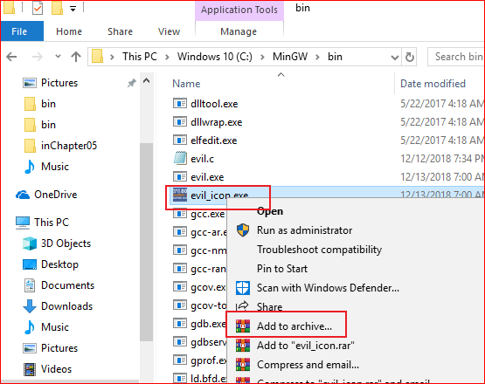

Slide 33
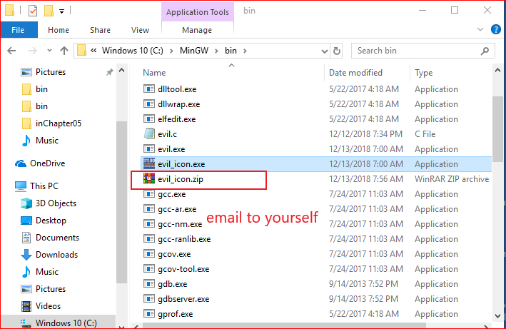

Slide 34
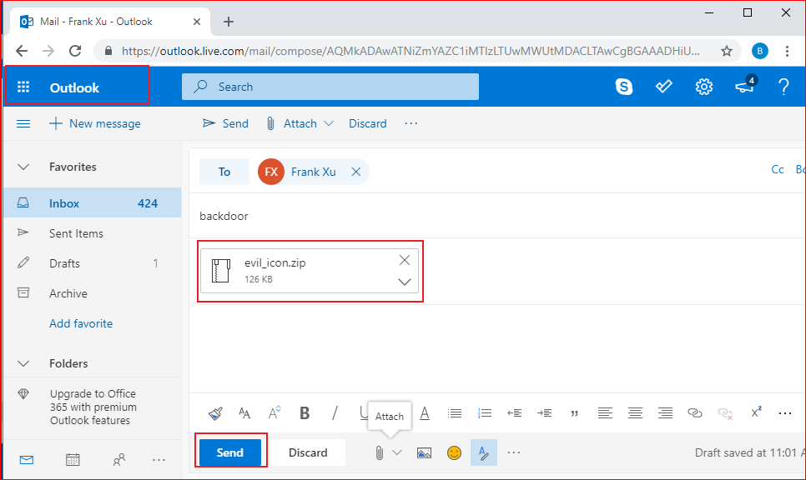

Slide 35
Change exe. to .jpg

Slide 36
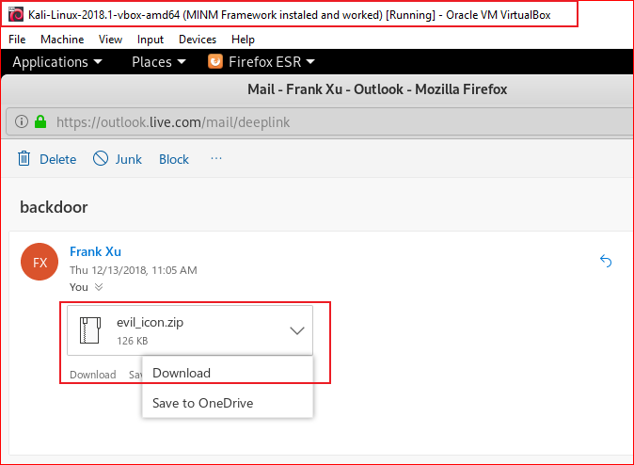
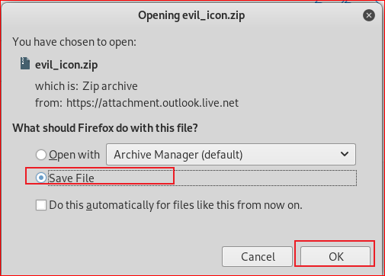
Download the zipped backdoor from your email

Slide 37
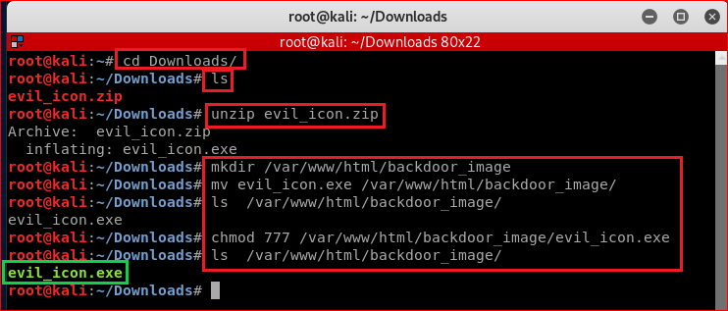

Slide 38
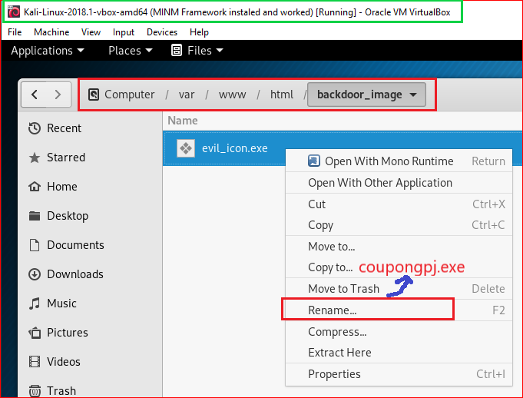
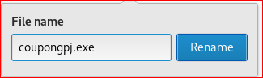

Slide 39
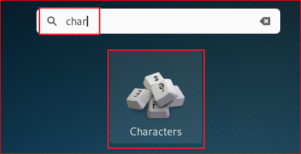
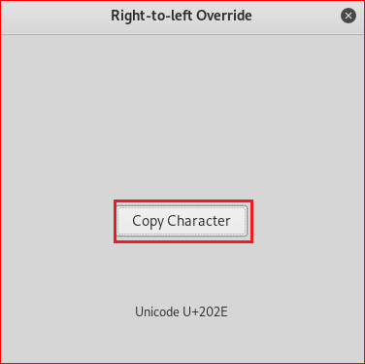
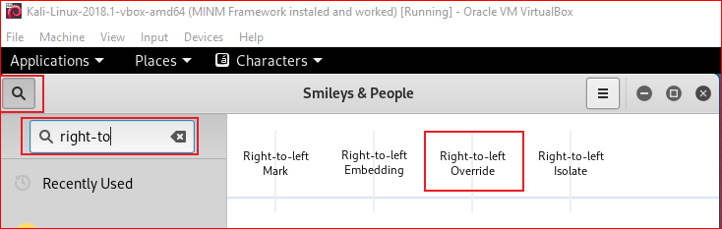

Slide 40
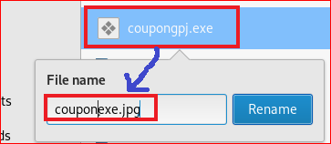
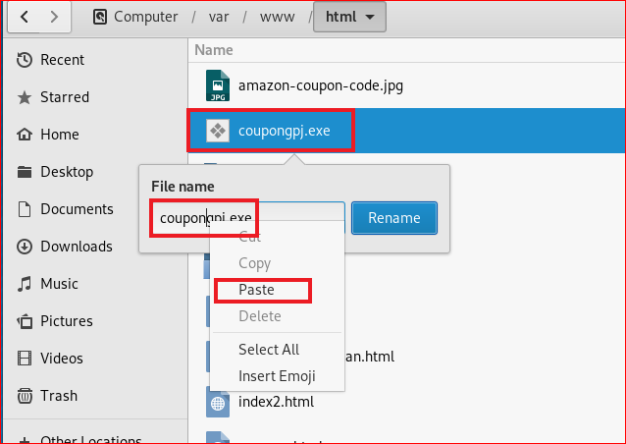
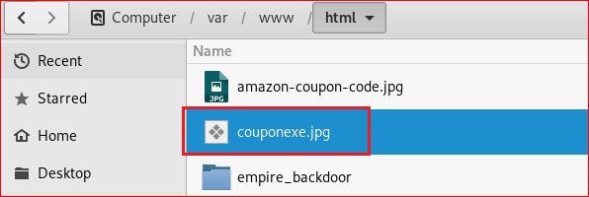

Slide 41
Attack

Slide 42
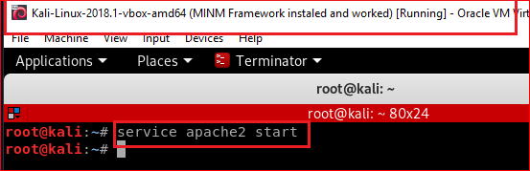

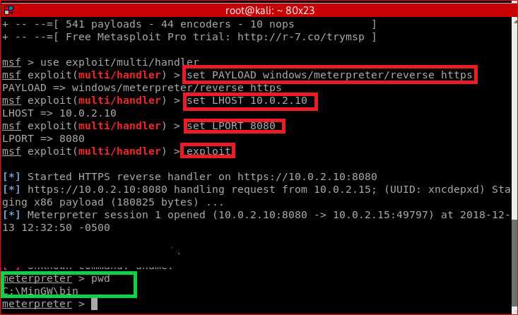

Slide 44
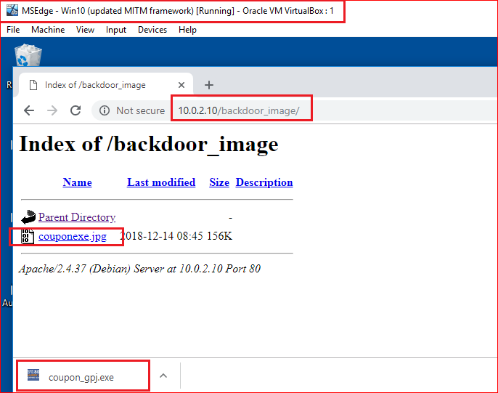

Slide 45
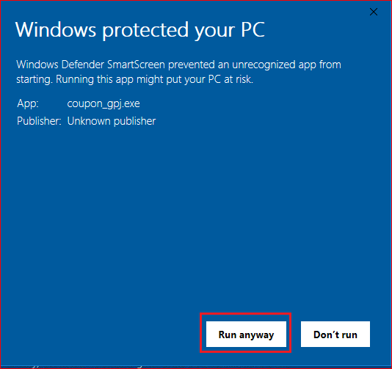

Slide 46
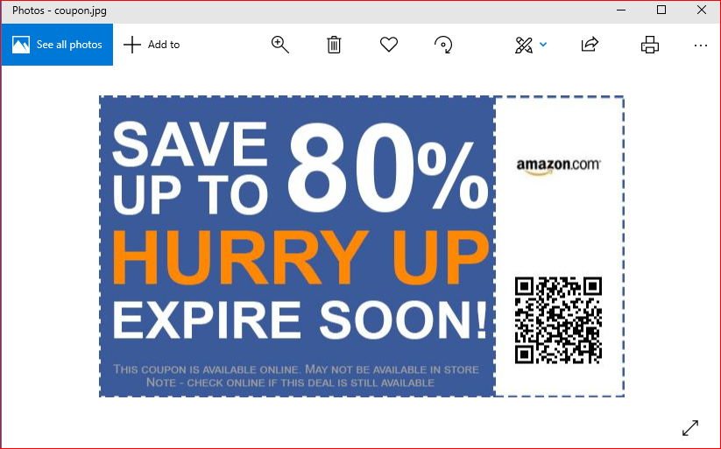

Slide 48
Create a rule for monitoring traffics
Your job is to find forensic evidence.
The evidence will tell us when intruder’s IP.

Slide 49
Reference
https://null-byte.wonderhowto.com/how-to/bypass-antivirus-using-powershell-and-metasploit-kali-tutorial-0167601/
https://null-byte.wonderhowto.com/how-to/hide-virus-inside-fake-picture-0168183/
https://www.sans.org/cyber-security-summit/archives/file/summit-archive-1492186586.pdf

